Slide 1



Leveraging Microservices & Kafka to Scale Developer Productivity
Mohinish Shaikh
mohinish@confluent.io
@mohinishbasha

Slide 2

Next ..
Microservices
Kafka
Notes:
Everyone knows about microservices, and kafka. We can just move to the next slides: understand about the developer productivity landscape.

Slide 3
How ..
What ..
Why ..
of Developer productivity
Notes:
trade offs

Slide 4
development ..
process ..
operations ..
engineering ..
devops ..
sre ..
pipelines ..
engineering services ..
platform infrastructure ..
whoami
Notes:
First off all, whoami

Slide 5
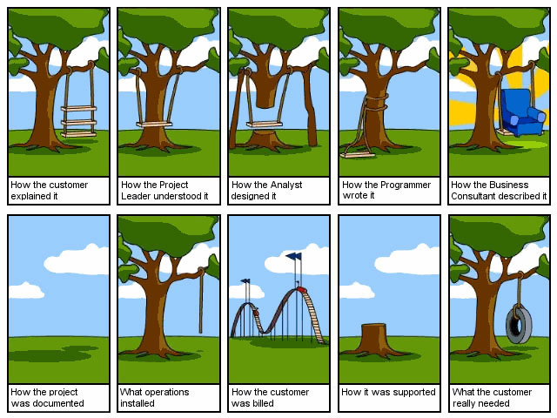
trust me .. i am an engineer

Slide 6
Developer productivity platform
Commits
Quality & Test Automation
Monitoring, Logging, Tracing
Builds, Releases & Deployments
Developer Productivity Platform
Security, Compliance & Audit
Packaging
Observability
CI/ CD across Stage, QA, Integ, Perf, Production
Infrastructure Management & Automation
* Productivity Intelligence
Notes:
what does developer productivity landscape looks like?

Slide 7
. . . anything & everything between commit to production and beyond ...

Slide 8
common
tools …
systems ..
frameworks ...
infrastructure …
standards …
architectural patterns ...
automation …
workflows …
workloads ...

Slide 9
Support
polyglot applications ..
quality ..
reliability ..
efficiency ..
environments ..
speed ..
time to market ..
roi ..

Slide 10
products expansion ..
lob ..
complementary services ..
bigger markets ..
partners ..
community ..
compliance ..
laws ..
geography ..
languages ..
culture ..

Slide 11
if ..
sales ..
promises ..
stuff ..
to ..
customers ….
Developer Productivity ..
helps the .. organization ..
Deliver with speed

Slide 12
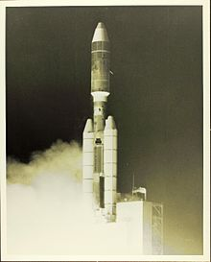
nasa helios 2 set a record speed of 157078 mph in 1976

Slide 13

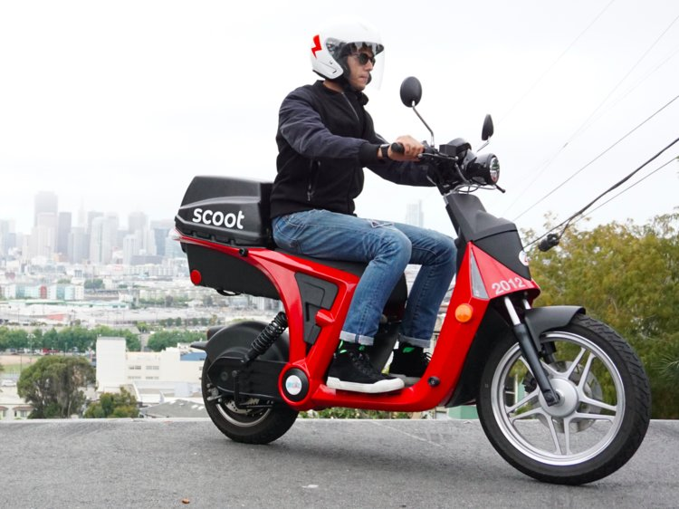
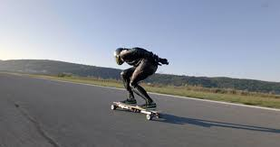



Slide 14

cohesive
hyperconverged
self serviced
self aware
agonistic pluggable

Slide 15

as organizations grow over time things become monolithic in nature & silo’d

Slide 16
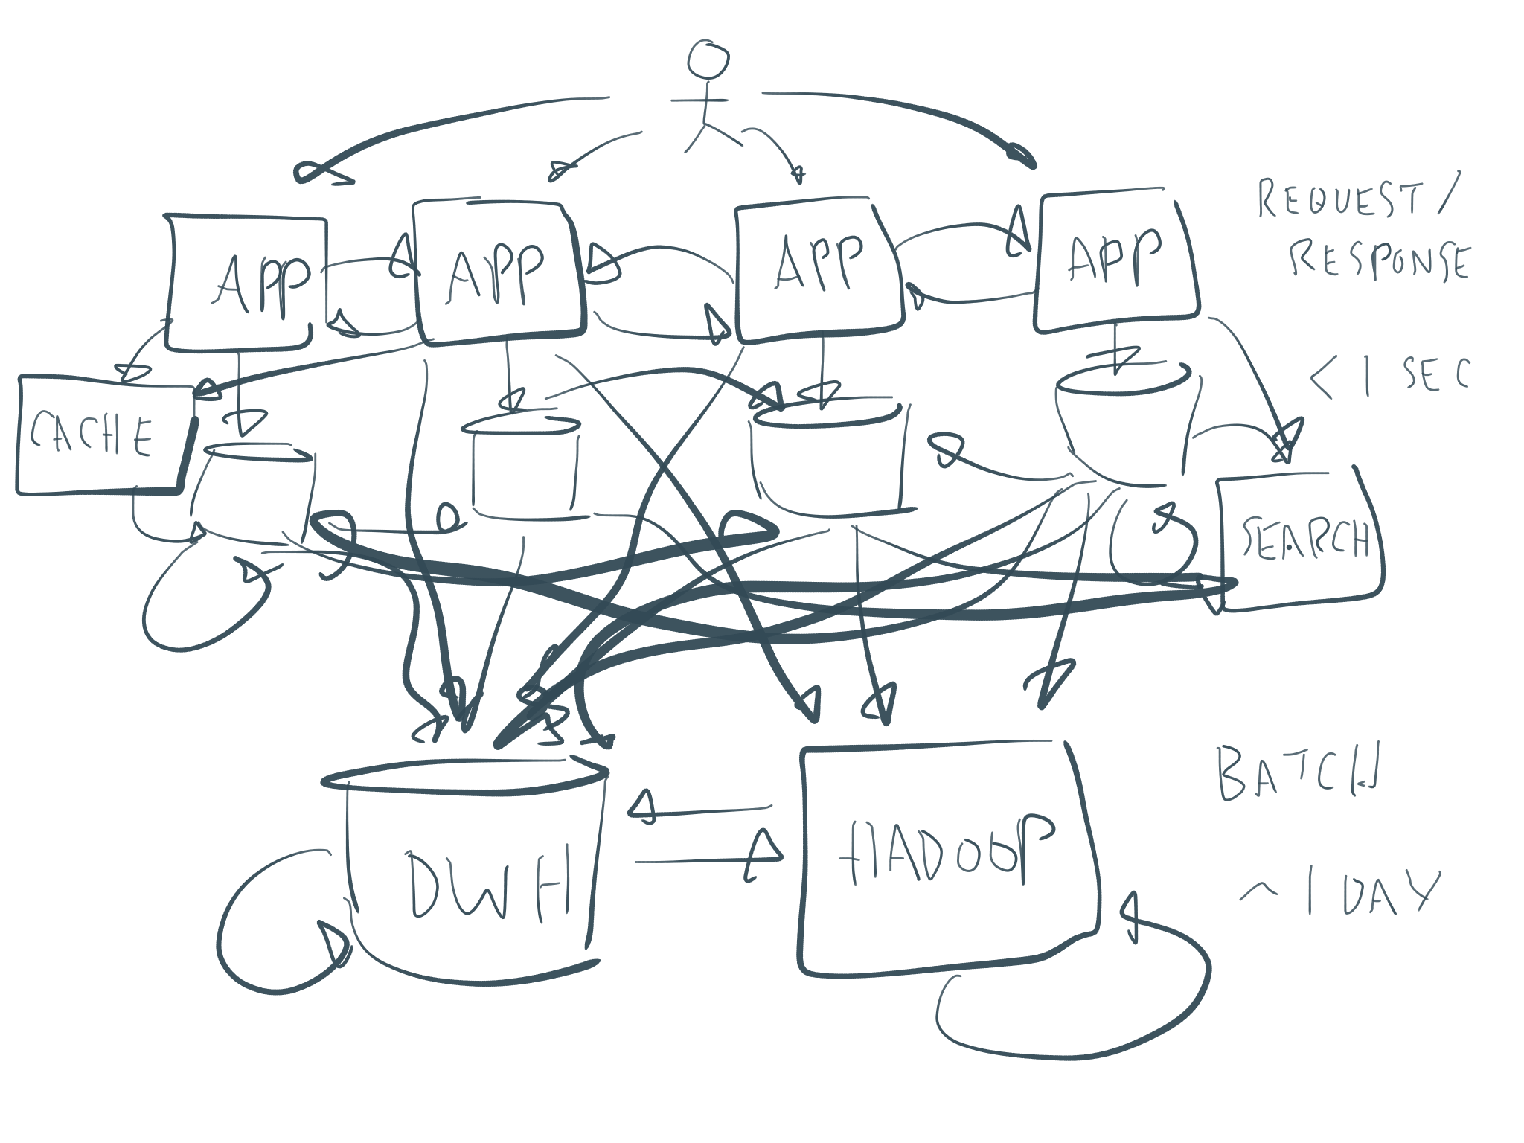
Notes:
monkey patched point solutions
Lots of systems catering to different productivity needs
Business units
N^2 connections
Tons of glue code to stitch it all together

Slide 17

Notes:
starts to look more like a patched wall.
Rigid, hard to break, slow, in-efficient

Slide 18
building a productivity platform that scales while avoiding monolithic traps & technical debt is the challenge

Slide 19
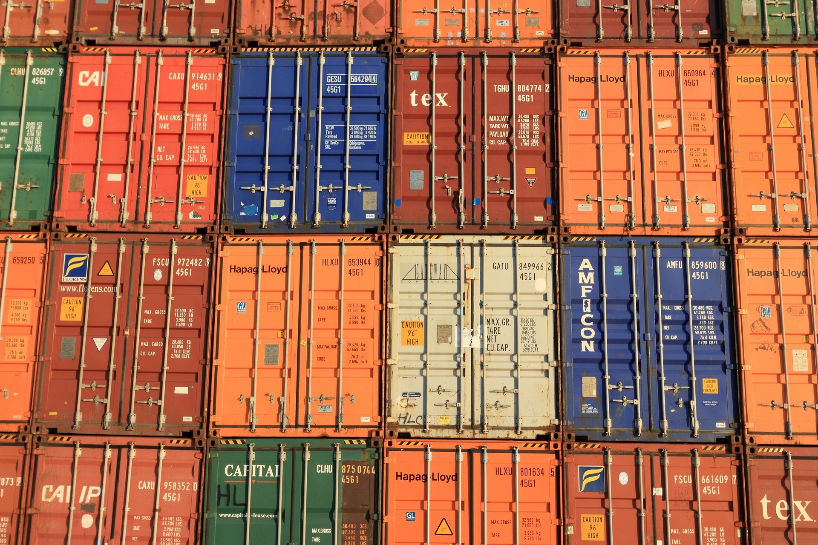
Notes:
Containerization helps breaking various components of the pipeline into smaller isolated tasks.

Slide 20
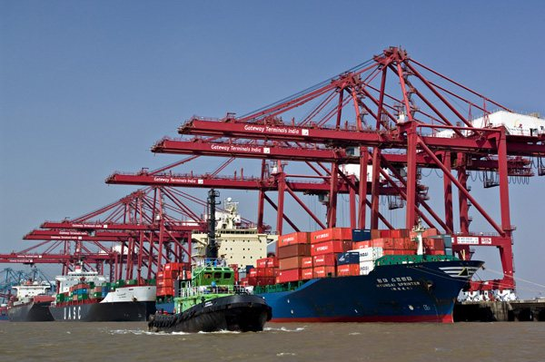
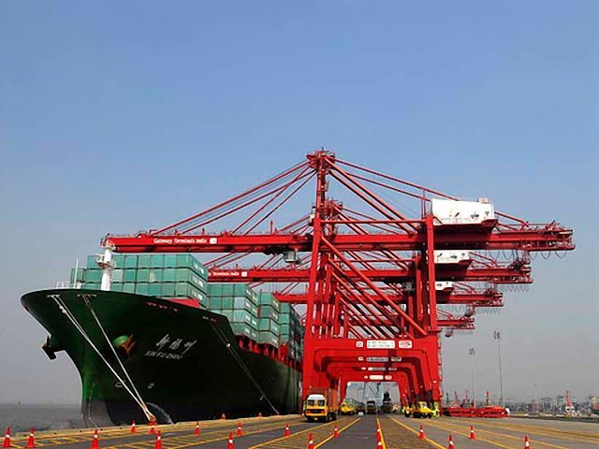
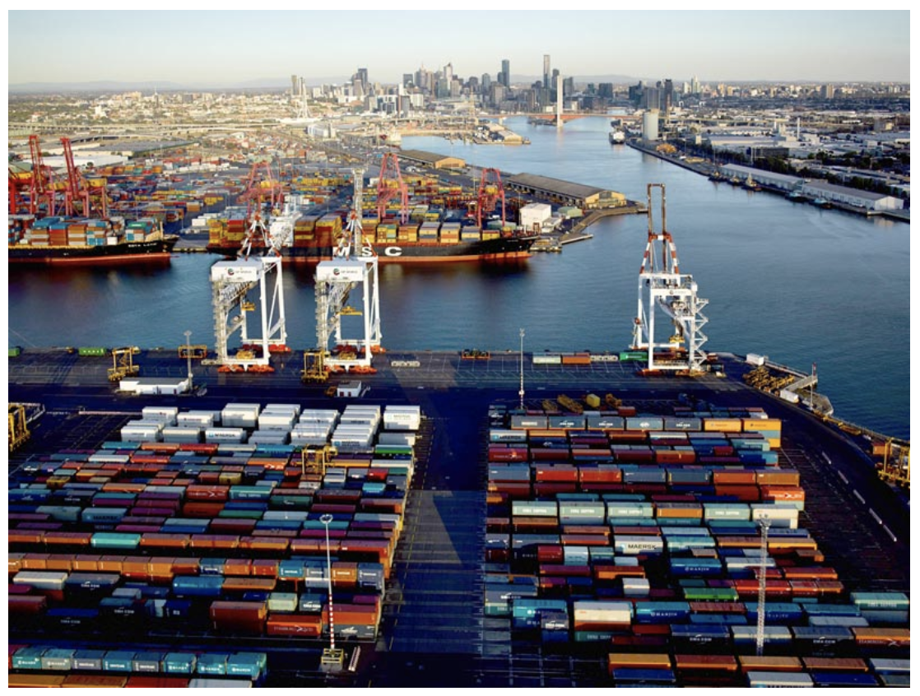
Notes:
Collectively they start working together using standard pipelines.
Pipelines for builds, releases, deployments, security, compliance etc. Helps organizations operate in self drive mode.

Slide 21

Notes:
with the ultimate goal to ship to production with quality, efficiency and speed.

Slide 22
pipelines
containerize tooling .. source code analysis ..
unit, functional, perf tests ..
builds, releases, packaging ..
deployments, infrastructure ..
automated ..
repeatable ..
de-coupled ..
systems ..
services ..
Notes:
We want to build pipelines:

Slide 23
cohesive
hyperconverged
self serviced
self aware
agonistic pluggable

Slide 24
Learn, adapter, evolve using a productivity intelligence system.
Notes:
As we build these systems, we want to constantly learn about failures, systems in operation. A productivity intelligence system helps to gather these insights. At paypal, productivity team has defined a metric: Failed Developer Interactions (FDI) that helps track failures across these pipelines.

Slide 25
Productivity platform
Mgmt. Infrastructure
Application Cluster
SCM
DB2
KV3
App1-v2
KV2
DB1
App2-v2
Builds
App8
Kafka
Kafka
Tests
App5
App7
Deployments
KV
Provisioning
DWH
DWH
DB3
Productivity Intelligence

Slide 26
Before: Many Ad Hoc Pipelines
Security
IaaS
Governance
Service Discovery/ KV
Logging, Tracing
Operational Metrics
Provisioning
Builds
Deployments
Compliance
Test Automation
Artifacts
Hadoop
Product1: App
Product2: App
Data Warehouse
Search
Security
Databases
Databases
Storage
Storage
General Application Architecture
Interfaces
Interfaces

Slide 27
After: Productivity Platform with Kafka
hyper-converged
cohesive
agnostic
Self serviceable
Security
Immutable IaaS
Governance
Service Discovery/ KV
Monitoring, Logging, Tracing
Kafka
Provisioning
Builds
Deployments
Compliance
Test automation
Artifacts
pipelines running productivity micro services
Hadoop
Product1: App
Product2: App
Data Warehouse
Search
Security
Kafka Streams
Kafka Streams
General Application Architecture

Slide 28
Management Cluster: future
Management Pipelines
Management Cluster
Provisioning
Tools Service pod
Tools Service pod
Builds, Release & Packaging
Tools container
build container
Test Infrastructure
Deployments
Tools container
build container
Artifacts
Native Kafka Java Applications
Native Kafka Java Applications
Productivity Intelligence

Slide 29
Code philosophy – Plan, Apply, Destroy
State: Maintain state of automation & infrastructure at all times.
KV
1
2
3
Plan generate a plan of execution
Execute Apply changes based on generated plan.
Destroy At any given point in time tools should be able to roll back
Configuration Keep configuration out of tooling.

Slide 30
Code philosophy – Conventions over Configuration
Scale: Helps scale productivity platform as conventions help drive repeatable patterns.
1
2
3
4
Configuration Helps reduce
Tool Chain Configuration drives Tooling behavior.
Pipeline Helps wrap common workflows
Conventions helps establish common patterns

Slide 31


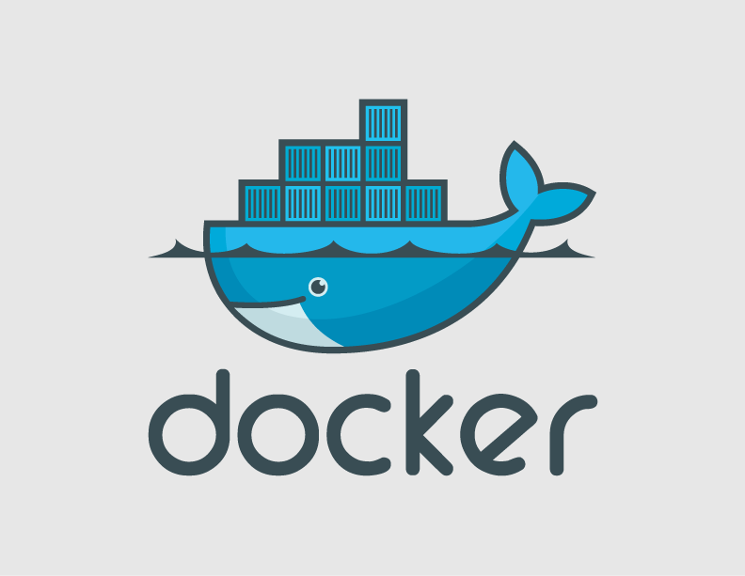







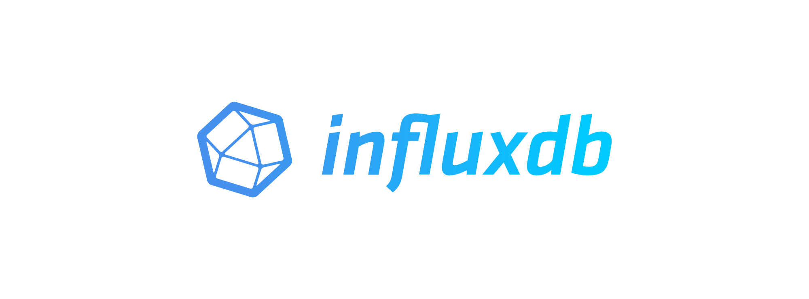
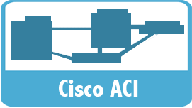


Notes:
At my last company, we built a infrastructure platform with:
commit to production - less than 15 mins. DR - 30 mins
Observability, Monitoring, Logging, Tracing as a first class citizen of infrastructure platform.
Immutable self-aware & self healing infrastructure. Testing pipelines with QA, Integ and Perf support. Enabled engineering to run fault injection attacks in production to keep learning about failures to improve the platform.

Slide 32
Q & A.
Mohinish Shaikh
mohinish@confluent.io
@mohinishbasha

